Slide 1
Building RAG apps in Python
Pamela Fox, Python Cloud Advocate
@pamelafox
pamelafox.org

Slide 2
RAG: Retrieval Augmented Generation

Slide 3




RAG: Retrieval Augmented Generation
The Prius V has an acceleration of 9.51 seconds from 0 to 60 mph.
How fast is the Prius V?
vehicle | year | msrp | acceleration |
--- | --- | --- | --- | --- | ---
Prius (1st Gen) | 1997 | 24509.74 | 7.46 |
Prius (2nd Gen) | 2000 | 26832.25 | 7.97 |
Prius (3rd Gen) | 2009 | 24641.18 | 9.6 |
Prius V | 2011 | 27272.28 | 9.51 |
Prius C | 2012 | 19006.62 | 9.35 |
Prius PHV | 2012 | 32095.61 | 8.82 |
Prius C | 2013 | 19080.0 | 8.7 |
Prius | 2013 | 24200.0 | 10.2 |
Prius Plug-in | 2013 | 32000.0 | 9.17 |
User
Question
Document Search
Large Language Model

Slide 4
RAG with OpenAI Python SDK
user_query = "How fast is the Prius V?"
retrieved_content = "vehicle | year | msrp | acceleration | mpg | class
--- | --- | --- | --- | --- | ---
Prius (1st Gen) | 1997 | 24509.74 | 7.46 | 41.26 | Compact
Prius (2nd Gen) | 2000 | 26832.25 | 7.97 | 45.23 | Compact..."
response = openai.chat.completions.create(
messages = [
{
"role": "system",
"content": "You must answer questions according to sources provided."
},
{
"role": "user",
"content": user_query + "\n Sources: \n" + retrieved_content
}
])
https://github.com/pamelafox/python-openai-demos/blob/main/retrieval_augmented_generation.py

Slide 5
RAG with OpenAI Python SDK + Azure AI Search
user_question = "What does a product manager do?"
user_question_vector = get_embedding(user_question)
r = search_client.search(user_question,
vector_queries=[VectorizedQuery(
vector=user_question_vector, fields="embedding")])
sources = "\n".join([f"[{doc[source']}]: {doc['content']}\n" for doc in r])
response = openai.chat.completions.create(
messages = [{
"role": "system",
"content": "You must answer questions according to sources provided."
},
{
"role": "user",
"content": user_query + "\n Sources: \n" + retrieved_content
}])

Slide 6
RAG app solution: Deep dive

Slide 7
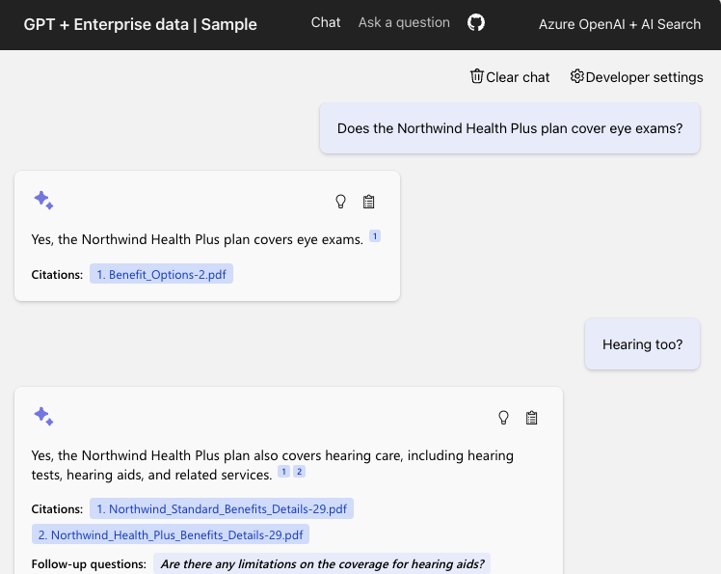
azure-search-openai-demo
Azure OpenAI +
Azure AI Search +
Azure App Service
Features:
Simple & Advanced RAG
Conversations ("multi-turn")
Optional vision integration
Optional speech input/output
Optional data access control
Code:
aka.ms/ragchat
Demo:
aka.ms/ragchat/demo

Slide 8





Application architecture
RAG flow
asks question
clicks citation
Azure
AI Search
Azure OpenAI
User
Azure
App Service
Azure Storage

Slide 9
"Ask" tab: Simple RAG flow
Yes, your company perks cover underwater activities such as scuba diving lessons ¹
Do my company perks cover underwater activities?
PerksPlus.pdf#page=2: Some of the lessons covered under PerksPlus include: · Skiing and snowboarding lessons · Scuba diving lessons · Surfing lessons · Horseback riding lessons These lessons provide employees with the opportunity to try new things, challenge themselves, and improve their physical skills.….
User
Question
Azure AI Search
Large Language Model

Slide 10
"Chat" tab: Advanced RAG flow
The Northwind Health Plus plan includes coverage for emergency services which are not included in the standard plan.
What is included in my Northwind Health Plus plan that is not in standard?
“Northwind Health Plus plan coverage details compared to standard plan”
“BenefitOptions1.pdf: Health Plus is a comprehensive plan that offers more coverage than Northwind Standard. Northwind Health Plus offers coverage for emergency services, mental health and substance abuse coverage, and out-of-network services, while Northwind Standard does not.”
Large Language Model
Azure AI Search
User
Question
Large Language Model

Slide 11

Azure AI Search approach
Vector
Keywords
For optimal retrieval, search() uses hybrid retrieval (text + vectors) plus the semantic ranker option.
https://aka.ms/ragrelevance
Fusion (RRF)
"Production-ready RAG with Azure AI Search"
Sept. 5, 7:00 PM UTC / 12:00 PM PT
aka.ms/raghack/aisearch
Reranking model

Slide 12
Code walkthrough
Typescript frontend
(React, FluentUI)
Python backend
(Quart, Uvicorn)
chat.tsx
makeApiRequest()
api.ts
chatApi()
app.py
chat()
chatreadretrieveread.py
run()
get_search_query()
compute_text_embedding()
search()
get_messages_from_history()
chat.completions.create()

Slide 13


Data ingestion process
This is a typical ingestion process that can be highly customized to meet the domain needs:
Azure Blob Storage
Azure Document
Intelligence
Azure OpenAI
Azure
AI Search
Python
Upload documents
An online version of each document is necessary for clickable citations.
Extract data from documents
Supports PDF, HTML, docx, pptx, xlsx, images, plus can OCR when needed.
Local parsers also available for PDF, HTML, JSON, txt.
Split data into chunks
Split text based on sentence boundaries and token lengths.
Langchain splitters could also be used here.
Vectorize chunks
Compute embeddings using OpenAI embedding model of your choosing.
Indexing
Document index
Chunk index
Both
Notes:
So here is what a data ingestion process could look like.
First, we store the documents in Azure Blob Storage, so that we have a version of the file that can be rendered as a citation in the app.
Then, we extract the text from the documents, using Azure Document Intelligence or a local parser.
Next, we split the data into chunks based on optimal token length and sentence boundaries.
We take those chunks and compute embeddings for them using an embedding model, like the Azure OpenAI embedding models.
Finally, we store the text, embedding, and Blob storage link inside the Azure AI search index.
This whole data ingestion process can run as a Python script locally, and that's what we've done in our open source RAG solution.

Slide 14
Hacking on azure-search-openai-demo
Getting the code
Deploying the app
Adding your own data
Local development
Customizing the frontend (UI)
Customizing the backend

Slide 15
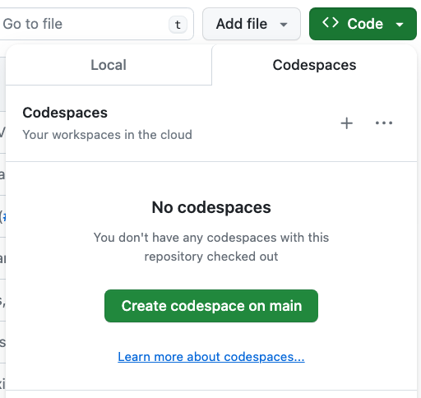
Opening the project: 3 options
GitHub Codespaces →
VS Code with Dev Containers extension
Your Local Environment
Python 3.9+
Node 14+
Azure Developer CLI
https://github.com/Azure-Samples/azure-search-openai-demo/?tab=readme-ov-file#project-setup

Slide 16
Deployment prerequisites
Azure account and subscription
A free account can be used, but will have limitations.
Access to Azure OpenAI or an openai.com account
Azure account permissions:
Microsoft.Authorization/roleAssignments/write
Microsoft.Resources/deployments/write on subscription level
https://github.com/Azure-Samples/azure-search-openai-demo/#azure-account-requirements

Slide 17
Deploying with the Azure Developer CLI
Login to your Azure account:
azd auth login --use-device-code
Create a new azd environment: (to track deployment parameters)
azd env new
Provision resources and deploy app:
azd up
💸 Deploy with free tiers following guide @ aka.ms/ragchat/free

Slide 18
Adding your own data
Remove existing sample data:
Add new documents to /data folder
Add new data
./scripts/prepdocs.sh --removeall
./scripts/prepdocs.sh
🔗 Data ingestion guide: Removing documents aka.ms/ragchat/remove-data
Notes:
Demo!

Slide 19
Starting the local server
cd app
./start.sh
Packages the React frontend typescript files using vite
Copies the JS into app/backend folder
Starts the Python app in reload mode (which only watches Python files!)
localhost:50505
cd app/frontend
npm run dev
Runs the frontend with hot reloading
localhost:5173

Slide 20
Customizing the frontend
Change this file: | To customize:
app/frontend/index.html | title, metadata, script tag
app/frontend/public/favicon.ico | browser tab icon
app/frontend/src/pages/layout/Layout.tsx | Navigation bar, colors
app/frontend/src/pages/chat/Chat.tsx | “Chat” tab and default settings
app/frontend/src/pages/ask/Ask.tsx | “Ask” tab and default settings

Slide 21
Customizing the backend
Change this file: | To customize:
app/backend/app.py | additional routes, app configuration
app/backend/approaches/chatreadretrieveread.py | “Chat” tab, RAG prompt and flow
app/backend/approaches/chatreadretrievereadvision.py | “Chat” tab, RAG flow when using vision
app/backend/approaches/retrievethenread.py | “Ask” tab, RAG prompt and flow
app/backend/approaches/retrievethenreadvision.py | “Ask” tab, RAG flow when using vision

Slide 22
Changing the prompt
Assistant helps the company employees with their healthcare plan questions, and questions about the employee handbook. Be brief in your answers.
Answer ONLY with the facts listed in the list of sources below. If there isn't enough information below, say you don't know. Do not generate answers that don't use the sources below. If asking a clarifying question to the user would help, ask the question.
For tabular information return it as an html table. Do not return markdown format. If the question is not in English, answer in the language used in the question.
Each source has a name followed by colon and the actual information, always include the source name for each fact you use in the response. Use square brackets to reference the source, for example [info1.txt]. Don't combine sources, list each source separately, for example [info1.txt][info2.pdf].

Slide 23
Choosing a Python web framework

Slide 24
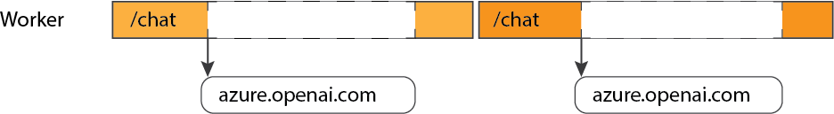
The problem with synchronous frameworks
A synchronous framework can only handle one request per worker:
https://blog.pamelafox.org/2023/09/best-practices-for-openai-chat-apps.html

Slide 25
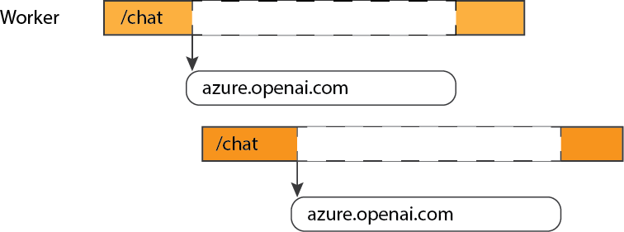
Asynchronous frameworks enable concurrency
An async framework can handle new requests while waiting on I/O:

Slide 26
Choose an async framework
@app.get("/chat")
async def chat_handler():
Library | Async? | Notes
Flask | ❌
Quart | ✅ | Async version of Flask. Similar interface, extensions.
FastAPI | ✅ | Built on Starlette, uses OpenAPI for autogenerated docs.
Starlette | ✅ | Lower level framework
Django | ⚠️ | Can be configured to support async
https://blog.pamelafox.org/2024/07/should-you-use-quart-or-fastapi-for-ai.html

Slide 27
...And use async calls with LLMs!
For the openai SDK, use AsyncAzureOpenAI constructor, then await:
client = openai.AsyncAzureOpenAI(
api_version=os.getenv("AZURE_OPENAI_VERSION"),
azure_endpoint=os.getenv("AZURE_OPENAI_ENDPOINT"),
azure_ad_token_provider=token_provider,
)
response = await client.chat.completions.create(
model=MODEL_NAME,
messages=[
{"role": "system", "content": "You are a helpful assistant."},
{"role": "user", "content": user_message}])

Slide 28
More RAG in Python solutions

Slide 29
What's in a RAG?
Component | Examples | SDKs
Embedding: (Optional) A model that converts a user query into a vector embedding, to be used by retrieval step. | OpenAI: ada-002, text-embedding-3 | openai
 | Azure AI Studio: Cohere Embed | azure-ai-inference
Retrieval: A knowledge base that can efficiently retrieve sources that match a user query (Ideally supports both vector and full-text search) | Azure AI Search, Azure Cosmos DB | Azure Python SDK
 | PostgreSQL | SQLAlchemy, psycopg2
Generation: A model that can answer questions based on the query based on the provided sources, and can include citations | OpenAI: GPT 3.5, GPT 4, GPT-4o | openai
 | Azure AI Studio: Meta Llama3, Mistral, Cohere R+ | azure-ai-inference

Slide 30
Optional: Orchestrators and LLM wrappers
Library | Focus | URL
Llamaindex | RAG and agentic flows | https://docs.llamaindex.ai/
Langchain | RAG and agentic flows, memory | https://python.langchain.com/
Semantic Kernel | RAG and agentic flows, memory | https://pypi.org/project/semantic-kernel/
Autogen | Agentic flows | https://microsoft.github.io/autogen/
Litellm | Proxy for many LLM hosts, load balancing | https://github.com/BerriAI/litellm
Prompty | Common way to write prompts and trace their calls | https://pypi.org/project/prompty/

Slide 31
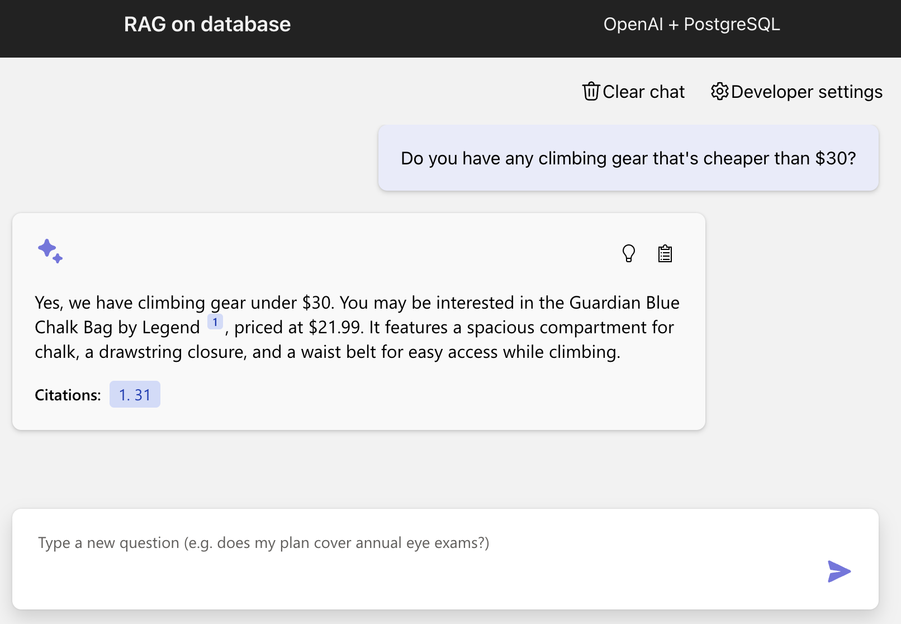
Open-source RAG chat solution: PostgreSQL
Retriever: PostgreSQL
LLM: GPT 3.5/4, + Ollama support
Orchestrator: None (OpenAI SDK)
Web framework: FastAPI
"Building RAG apps with
PostgreSQL"
Sept. 5, 9:00 PM UTC / 2:00 PM PT
aka.ms/raghack/cosmosdb
https://github.com/Azure-Samples/rag-postgres-openai-python

Slide 32
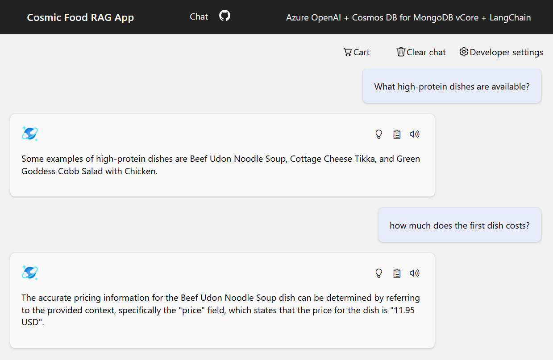
Open-source RAG chat solution: CosmosDB MongoDB
Retriever: Cosmos DB for MongoDB vCore
LLM: GPT 3.5/4
Orchestrator: LangChain
Web framework: Quart
"Building RAG apps with
CosmosDB Mongo DB"
Sept. 5, 5:00 PM UTC / 10:00 AM PT
aka.ms/raghack/cosmosdb
https://github.com/Azure-Samples/Cosmic-Food-RAG-app

Slide 33
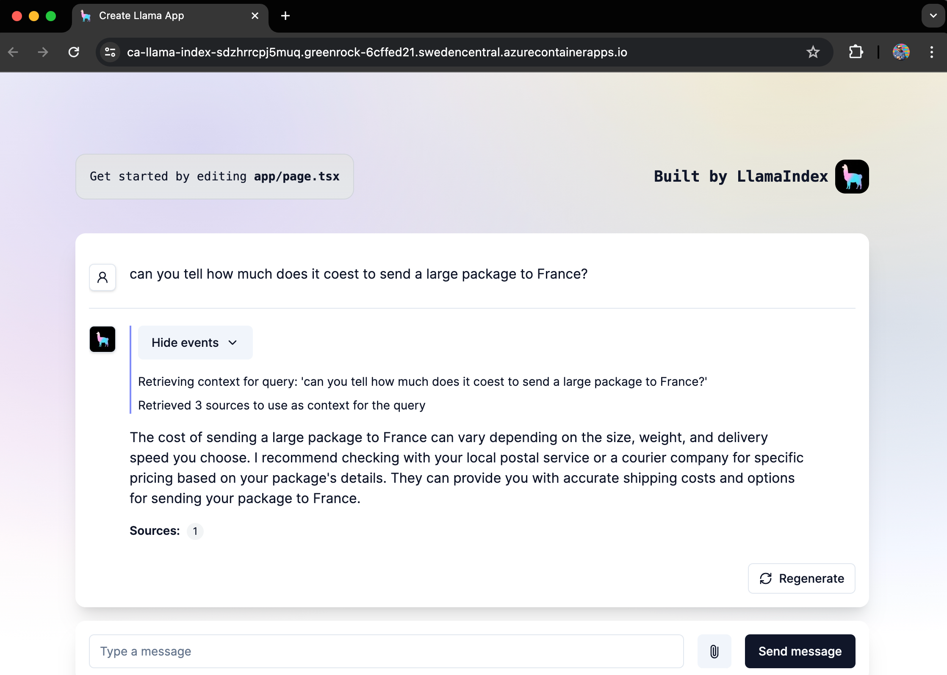
Open-source RAG chat solution: Llamaindex
Retriever: In-Memory
LLM: GPT 3.5/4
Orchestrator: Llamaindex
Web framework: FastAPI
https://github.com/Azure-Samples/llama-index-python

Slide 34
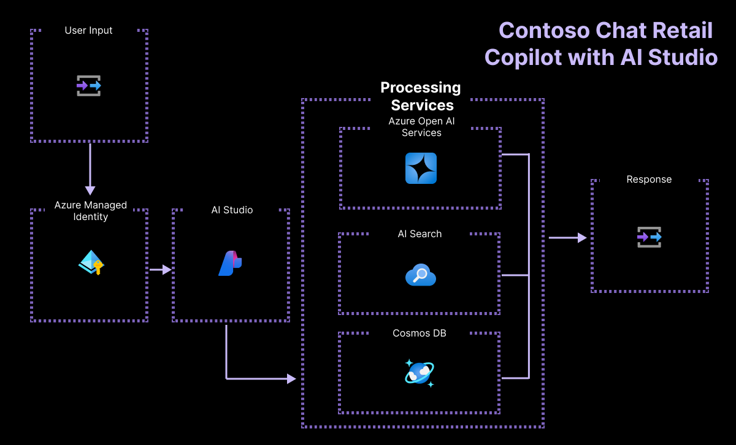
Open-source RAG chat solution: Azure AI Studio
Retriever: Azure AI Search
LLM: GPT 3.5/4
Orchestrator: PromptFlow
Features:
CosmosDB user info lookup
"Building RAG apps with
Azure AI Studio"
Sept. 9, 3:00 PM UTC / 8:00 AM PT
aka.ms/raghack/aistudio
https://github.com/Azure-Samples/contoso-chat

Slide 35
Start RAGing in Python!
Attend upcoming streams!
RAG with Azure AI Search:
aka.ms/raghack/aisearch
RAG with PostgreSQL:
aka.ms/raghack/postgres
RAG with vision models:
aka.ms/raghack/vision
Langchain for Agentic RAG:
aka.ms/raghack/langchain
OpenAI Code Interpreter for Python:
aka.ms/raghack/coderunner
RAFT (RAG + Fine-tuning)
aka.ms/raghack/raft
Evaluating your RAG chat app
aka.ms/raghack/evals
Deploy a RAG solution like aka.ms/ragchat/free
Or start from scratch!
Come to Pamela's Office Hours on Wednesday in Discord
Post questions in the repo issue tracker or aka.ms/raghack discussions
...and more!

